Slide 1
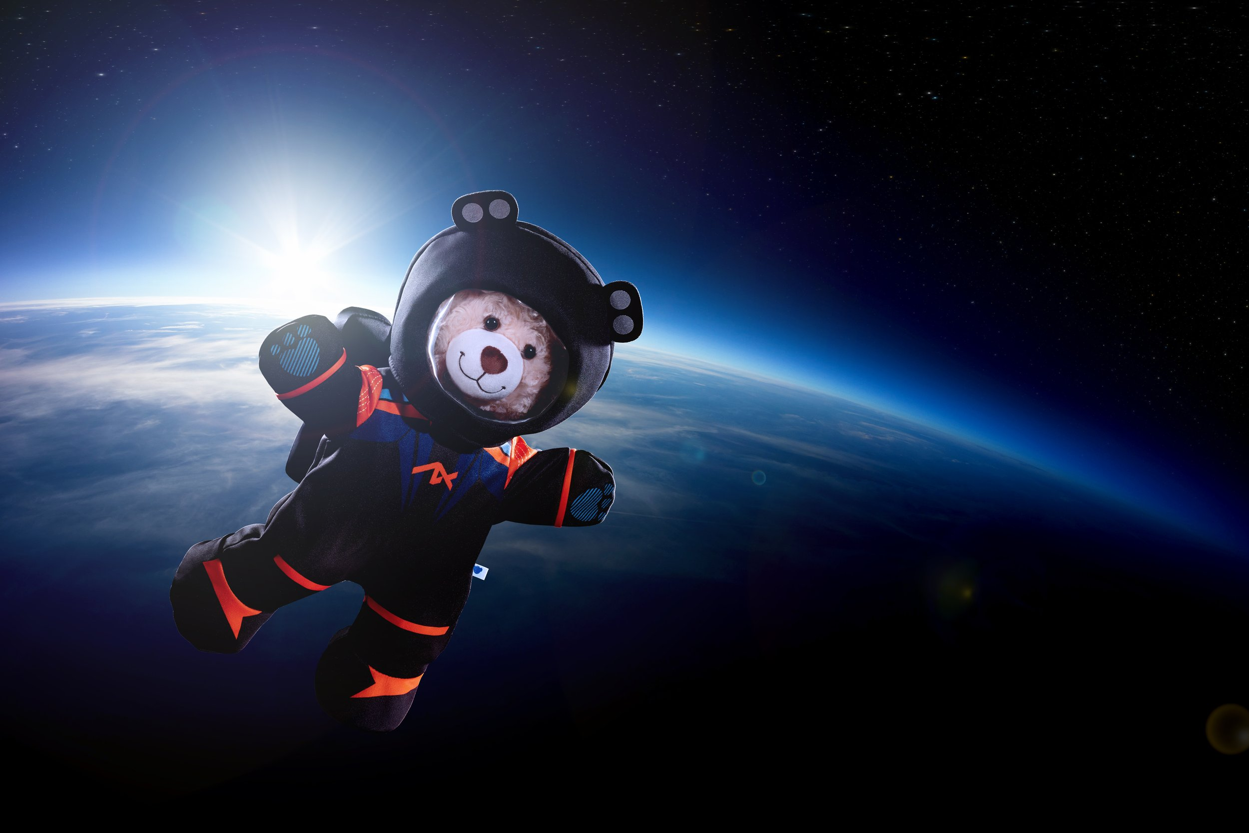
BUILD-A-PLANET
Jenna Bittner, Hannah Egg, Nathan Holty
Group 4

Slide 2
MOTIVATION
Transit and RV are the most accessible and widely used detection methods
Thus, mass and radius are the most reliable measurements for most exoplanets
Mass and radius can give us bulk density
We want to see what else can be inferred about interior structure and composition using those two parameters

Slide 3
METHODS Warm-up
Bigger iron core, smaller silicate mantle
High Fe/Mg ratio
Mg-silicate-rich planet, smaller core, lower density
Low Fe/Mg ratio
Promotes silica-rich materials, reduces Mg-rich material, denser mantle
High Si/Mg ratio
Smaller core, Fe-rich mantle
Higher FeO fraction in mantle vs. metallic Fe

Slide 4
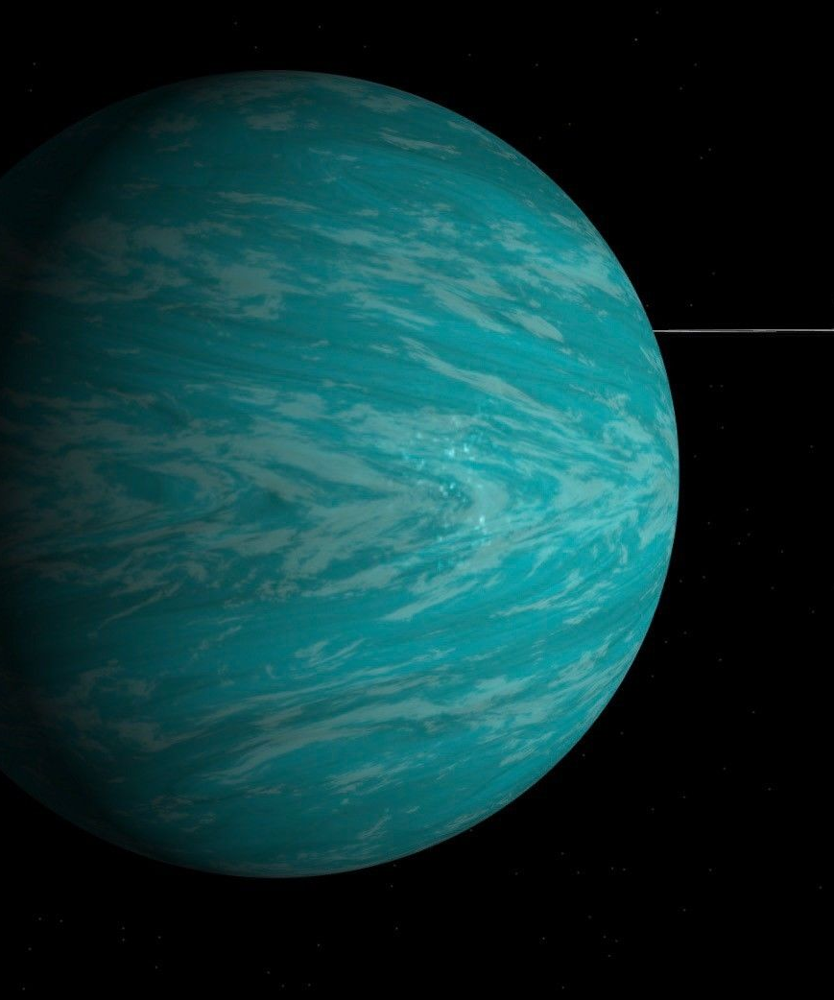

METHODS
Calculate the molar ratios Fe/Mg and Si/Mg
Reported stellar metallicity
[Fe/H] = 0.04
Use empirical relations from literature to infer ratios
[Mg/H] = -0.2 x [Fe/H] = -0.008
[Si/H] = -0.18 x [Fe/H] = -0.0072
Convert to linear abundance
$X_{rel}={10}^{[X/H]}$
$\frac{Fe}{Mg}={\left(\frac{Fe}{Mg}\right)}_{⊙} x \left(\frac{{Fe}_{rel}}{{Mg}_{rel}}\right)$
$\frac{Si}{Mg}={\left(\frac{Si}{Mg}\right)}_{⊙} x \left(\frac{{Si}_{rel}}{{Mg}_{rel}}\right)$
[Fe/Mg] = 1.005
[Si/Mg] = 0.902
TRAPPIST-1b

Slide 5
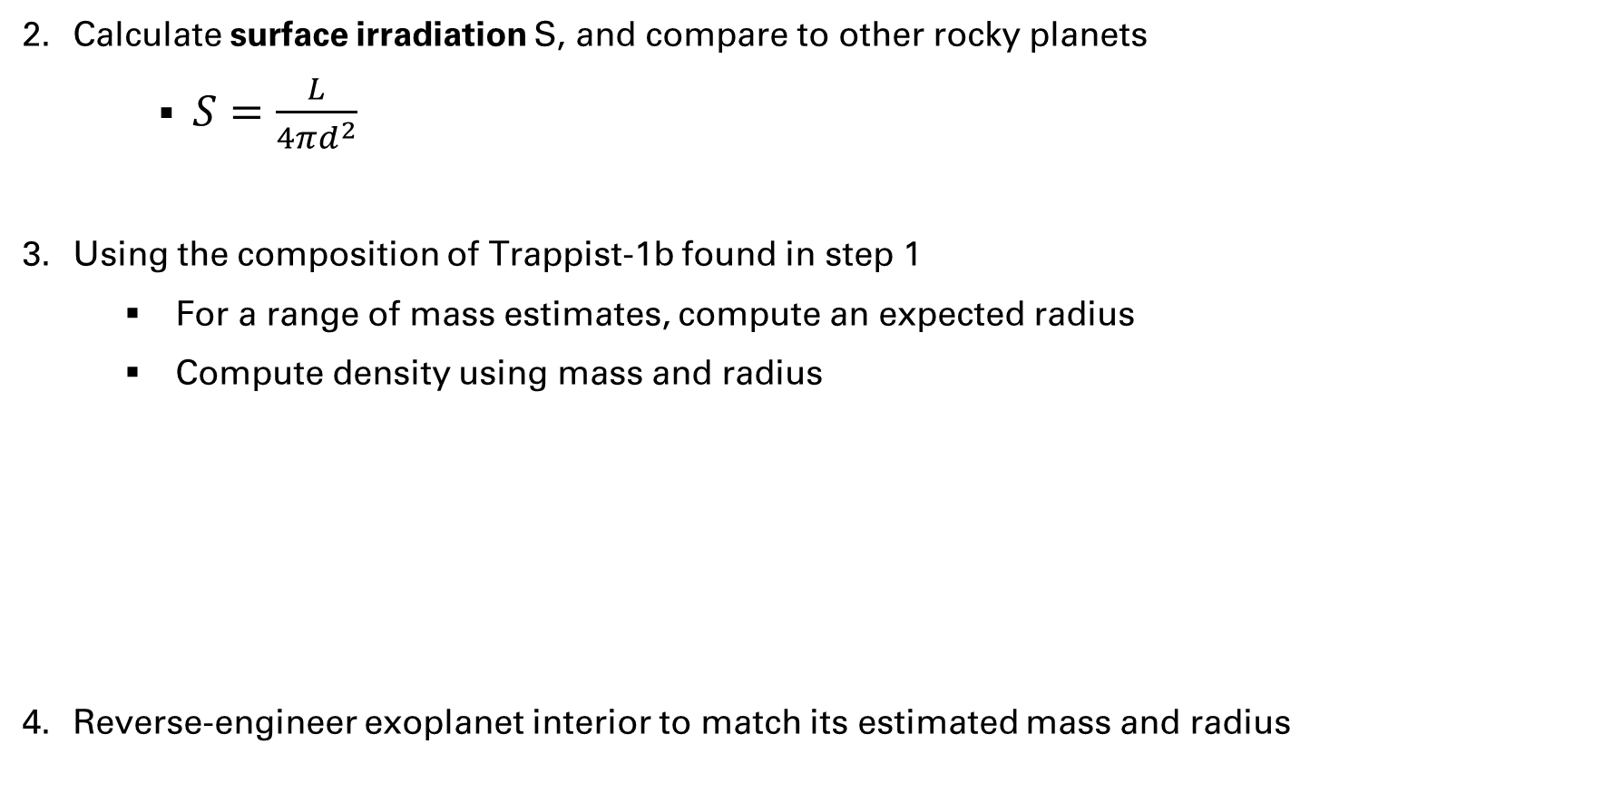
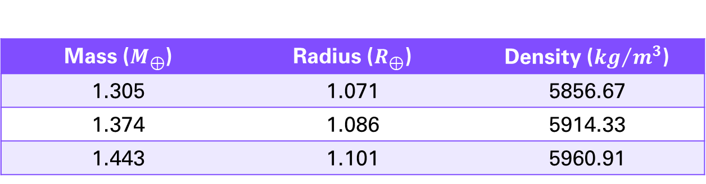
METHODS
Calculate surface irradiation S, and compare to other rocky planets
$S=\frac{L}{4πd^{2}}$
Using the composition of Trappist-1b found in step 1
For a range of mass estimates, compute an expected radius
Compute density using mass and radius
Reverse-engineer exoplanet interior to match its estimated mass and radius
L → stellar luminosity
d → orbital distance
Mass ($M_{⊕}$) | Radius ($R_{⊕}$) | Density (${kg}/{m^{3}}$)
1.305 | 1.071 | 5856.67
1.374 | 1.086 | 5914.33
1.443 | 1.101 | 5960.91

Slide 6
Results
Adjust parameters related to the mantle composition and core mass fraction to match its measured mass and radius
Fe/Mg ratio in mantle | 0.90 | Extremely iron-rich, much higher than Earth | Increase mantle density, decrease planetary radius
Si fraction in core | 0.1 | Similar to Earth, slightly higher | Reduces core density, balancing dense mantle
Si/Mg ratio in mantle | 0.902 | Similar to Earth, slightly lower | Slightly reduces mantle density
O fraction in core | 0.1 | Very high compared to Earth | Further reduces core density while preserving planetary radius
S fraction in core | 0.22 | Higher than Earth, but possible for volatile-rich planets | Make core much less dense, increases radius

Slide 7
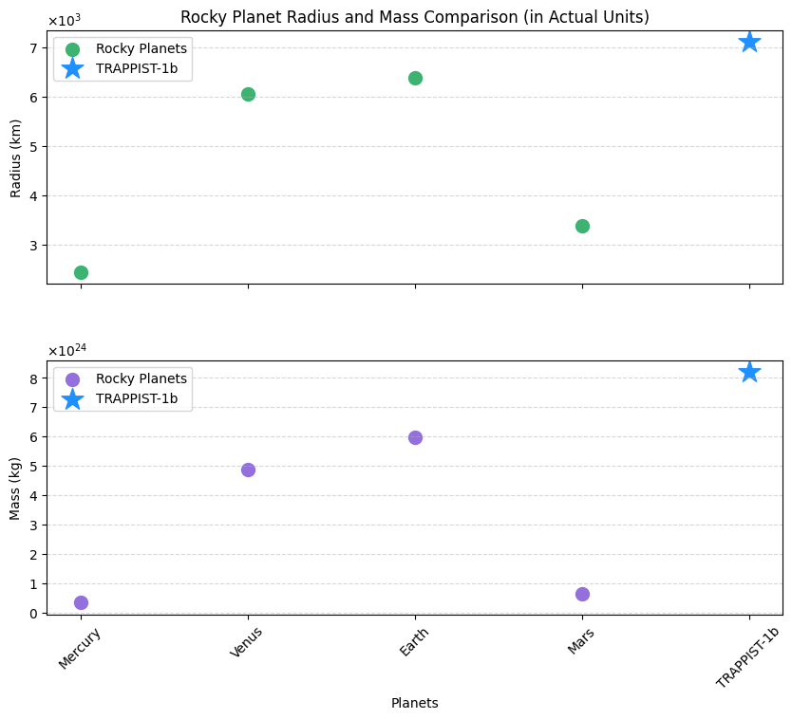
Results
Compare Trappist-1b to other rocky planets

Slide 8
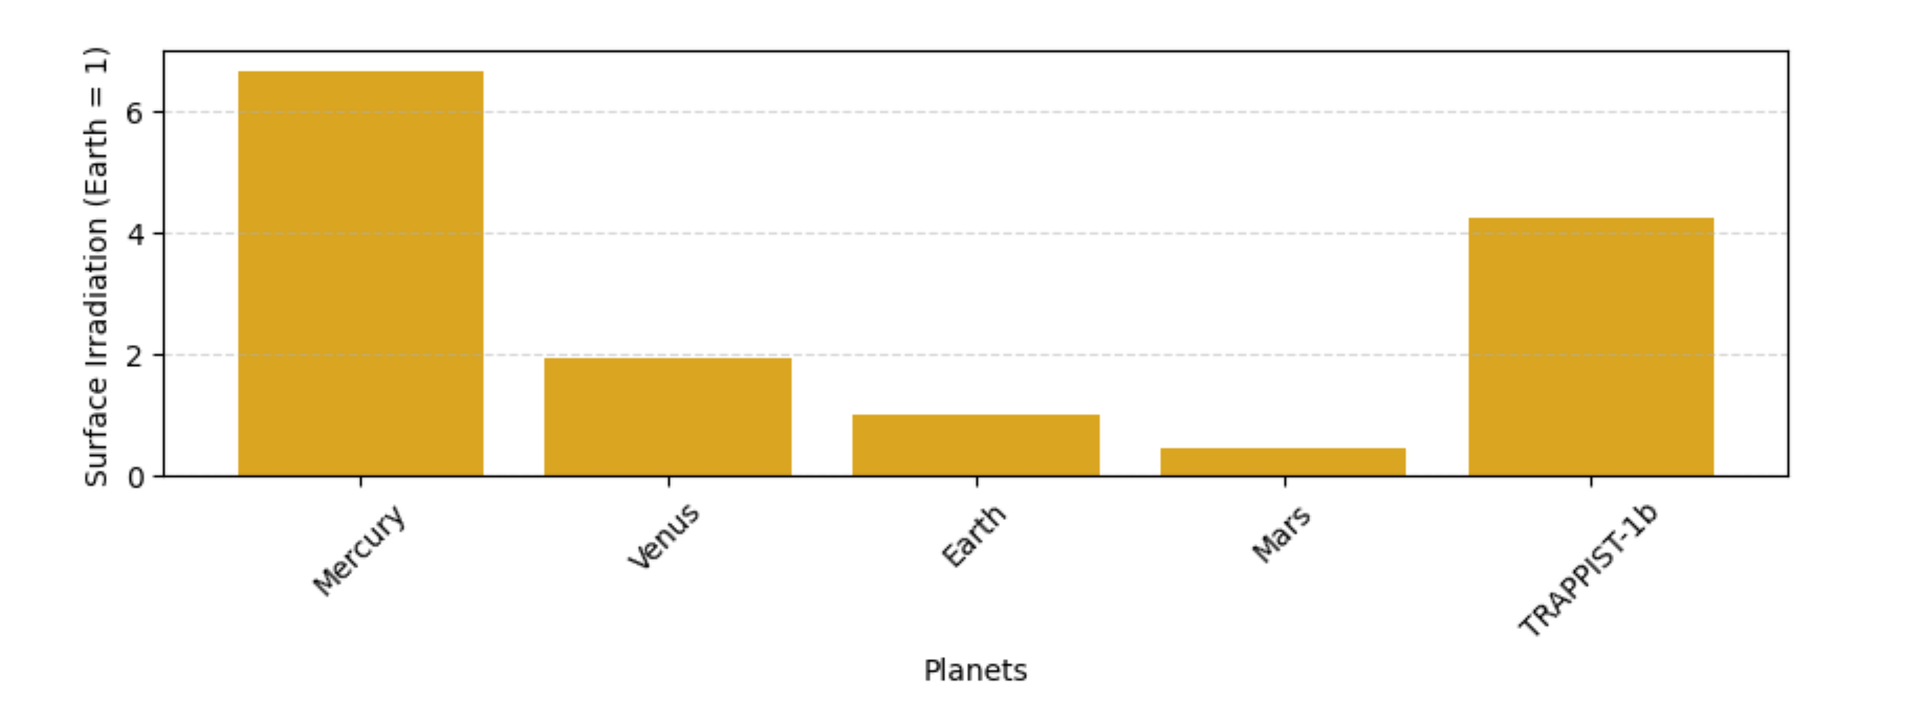
Results
Surface irradiation

